Slide 1
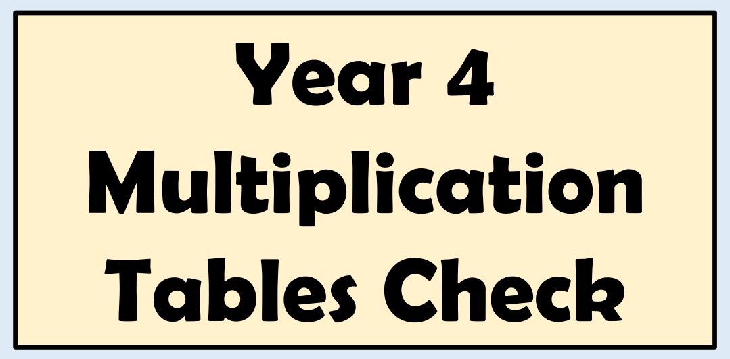

Slide 2
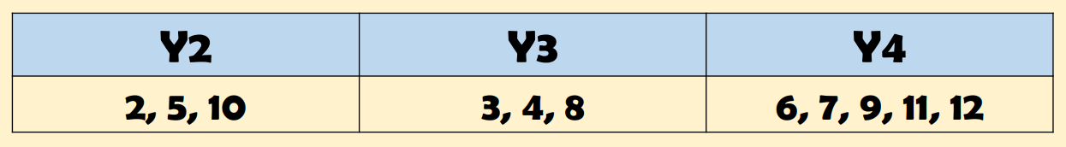
Back in 2019, the Government announced a new ‘test’ for year 4 children called the ‘Multiplication Tables Check’.
This is similar to the Y1 Phonics Screening Check
There is no ‘pass’ rate or threshold which means that unlike the Phonics Screening Check children will not be expected to re-sit the check.
By end of Y4, children are expected to be able to instantly recall multiplication facts up to 12 x 12.

Slide 3
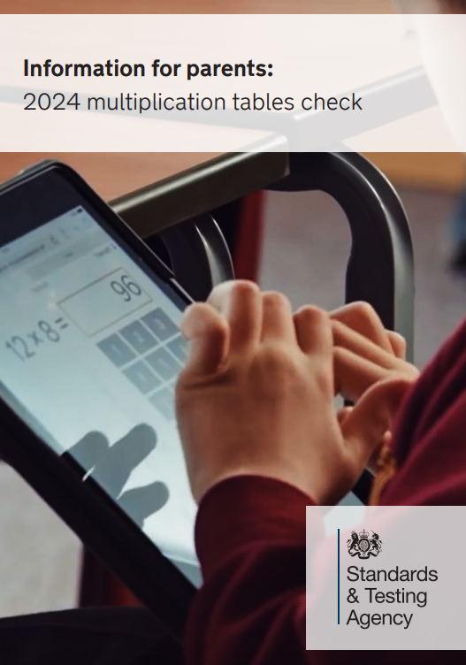
It will take place during a two-week window commencing Monday 3rd June.
We will try and complete this in the 1st week.
No expectation for all children to complete the check on the same day.

Slide 4
The check is online and on-screen.
At Owslebury, it will be using ipads.
It will take less than 5 minutes per child.
The test comprises of 25 questions.
There will be 3 practice questions before the check begins.
Children will get 6 seconds to answer each question, with a 3 second pause between each question.
Instant recall is therefore really important
(i.e. recalling 6 x 7 without having to count in multiples)

Slide 5
There will only be multiplication questions in the check, not division facts.
Each child will be randomly assigned a set of questions.
Whatever is in the box at the end of the time will be counted (don’t have to press enter)
Children will not see their individual results when they complete the check.
SEN – Teachers can enter answers

Slide 6
By end of Y4, children are expected to be able to instantly recall multiplication facts up to 12 x 12, as well as the related division facts
Let’s have a go…

Slide 7
5 x 8 =

Slide 8
3 x 7 =

Slide 9
6 x 9 =

Slide 10
4 x 10 =

Slide 11
7 x 8 =

Slide 12
Well done!

Slide 13
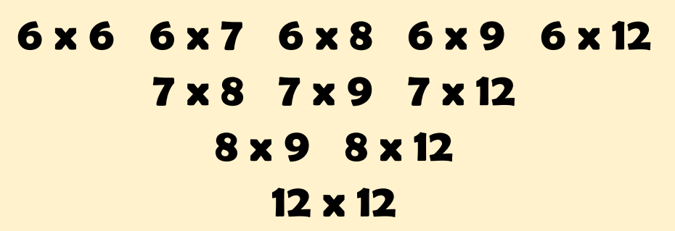
Not always an even spread of questions!
The 11 facts more likely to be asked:

Slide 14

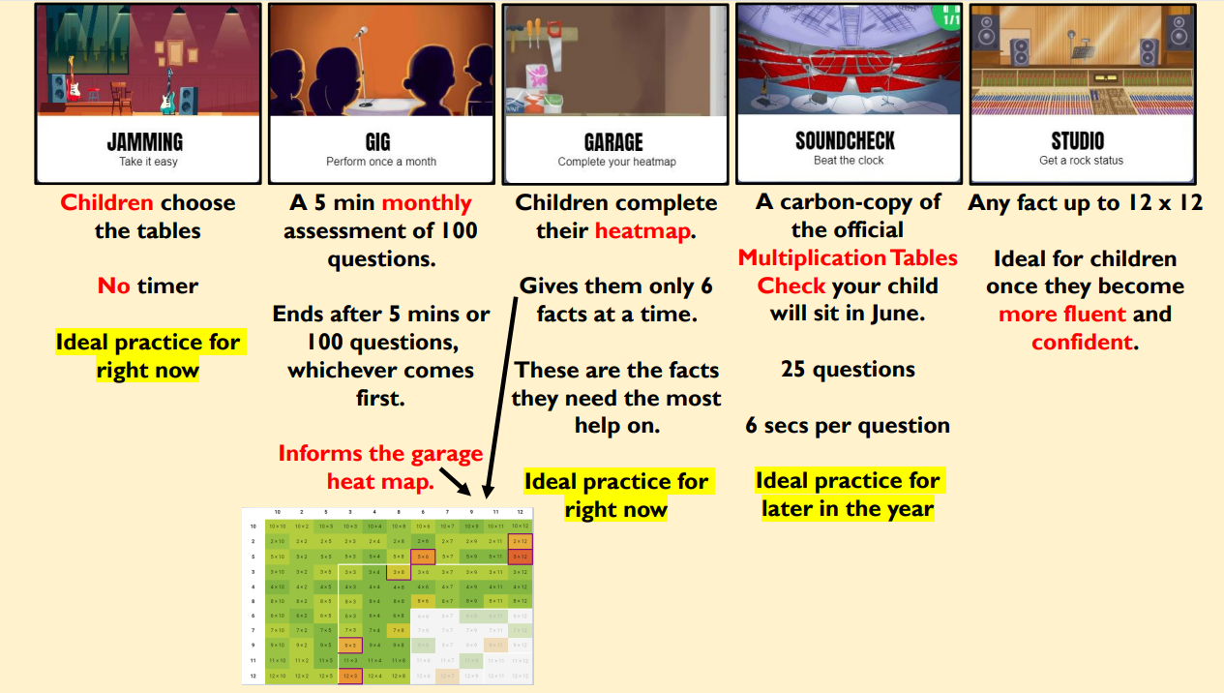
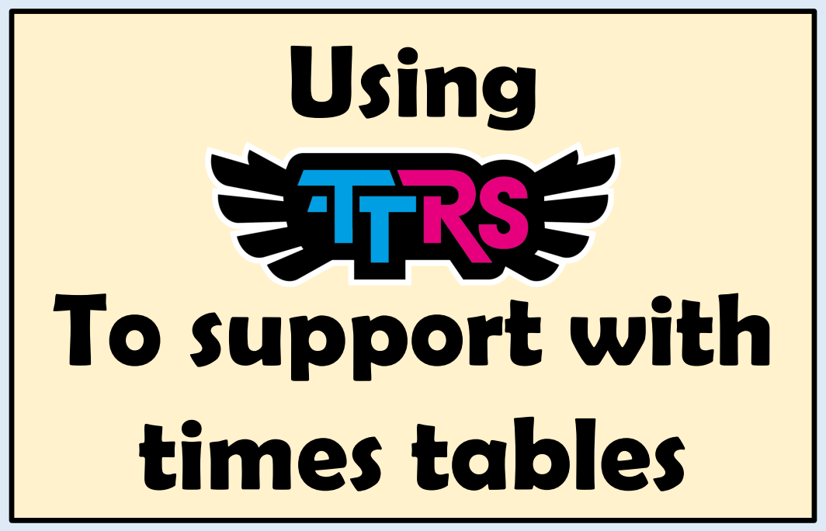

Slide 15
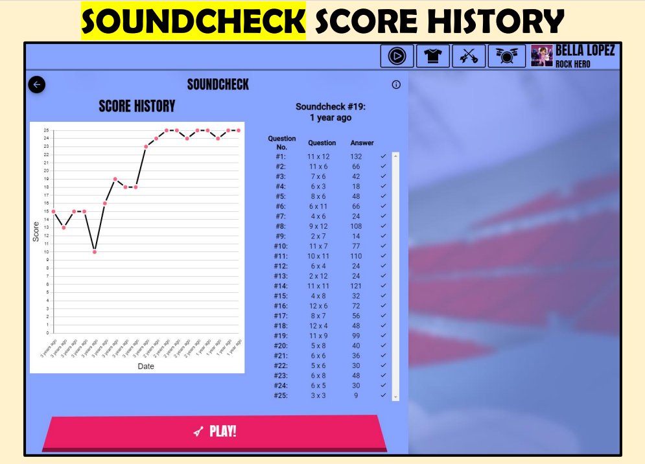
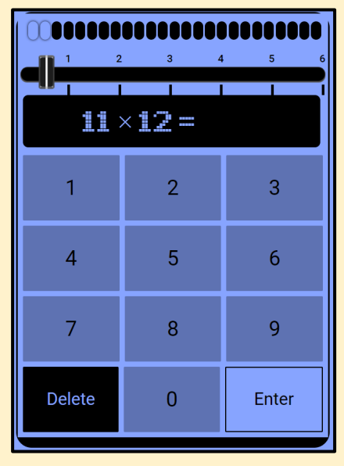

Slide 16
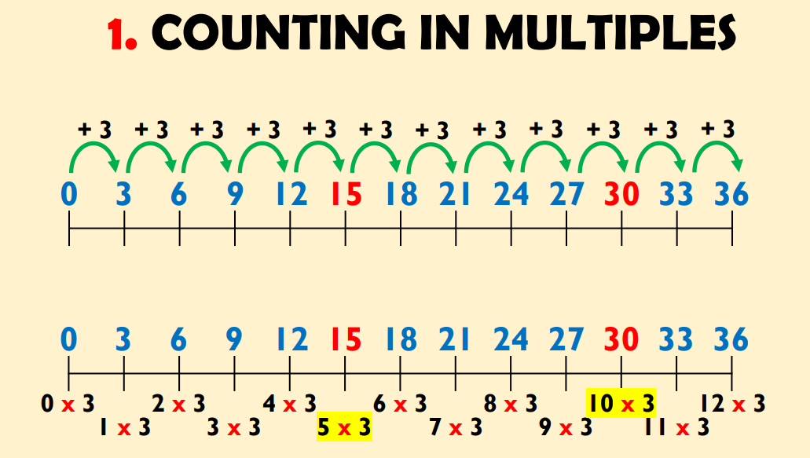
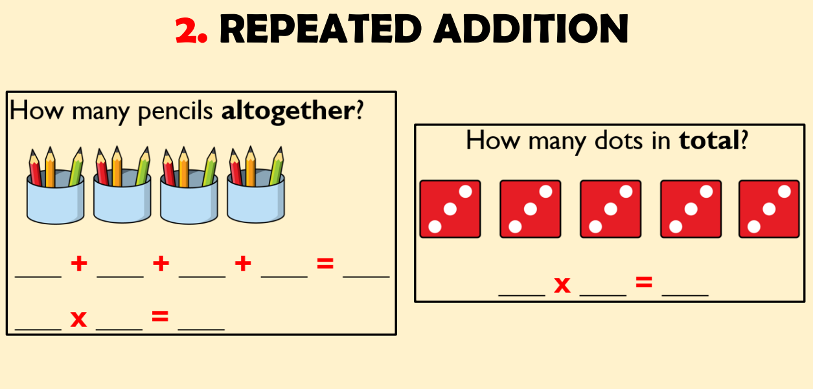

Slide 17
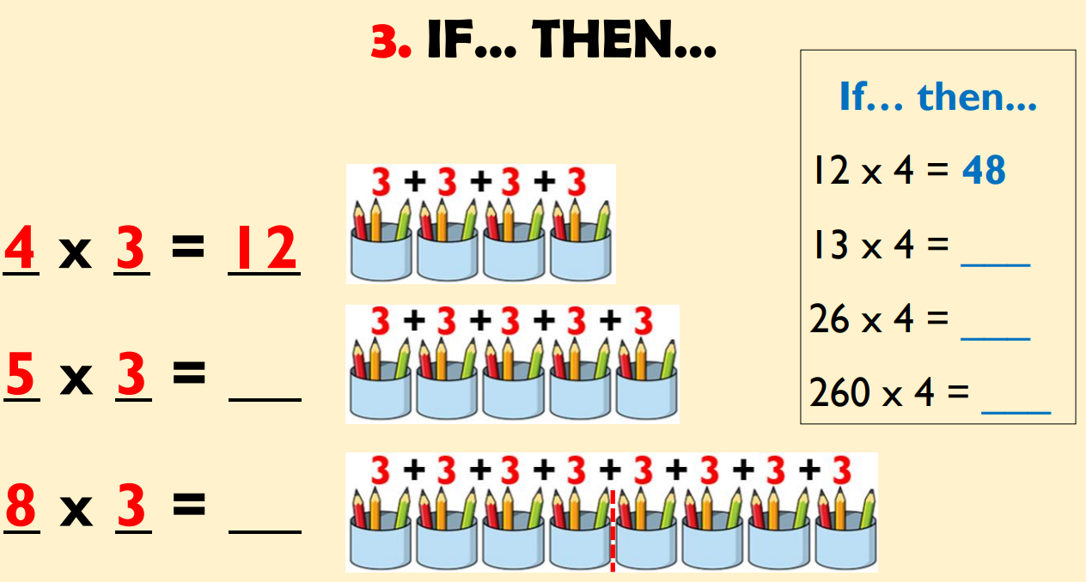
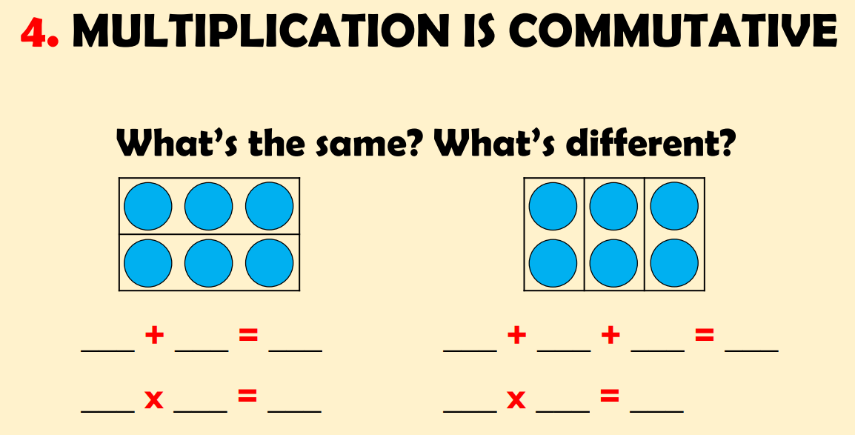

Slide 18


