Slide 1

Phonics

Slide 2
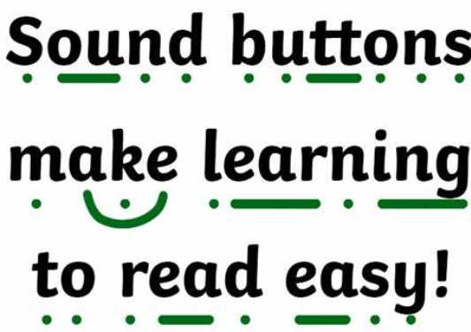
What is phonics?
Children are taught to read by breaking down words into separate sounds (segmenting). They are then taught how to blend these sounds together to read the whole word.
c-a-t cat d-o-g dog f-i-sh fish b-ear-d beard
Recognise sounds that each letter makes
Identify sounds that different combinations of letters make (oo, sh, ck)
Blend letters together from left to right
Children then use this knowledge to decode unfamiliar words

Slide 3
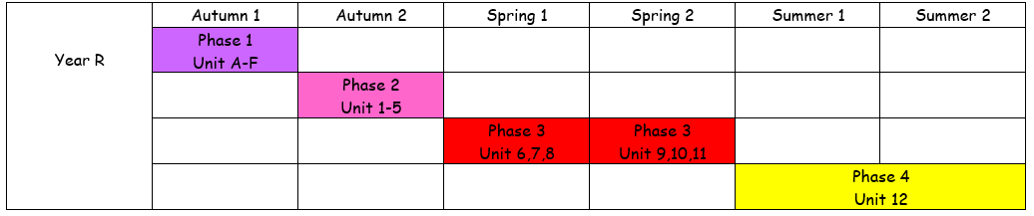
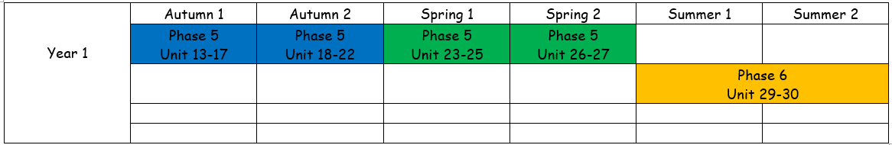
Phonics overview

Slide 4
Bug Club
Alphabet song (letter names)
Flashcards
Revise previous sounds
Teach new sound
Spelling words with new sound
Put new sounds into a sentence
Lesson

Slide 5
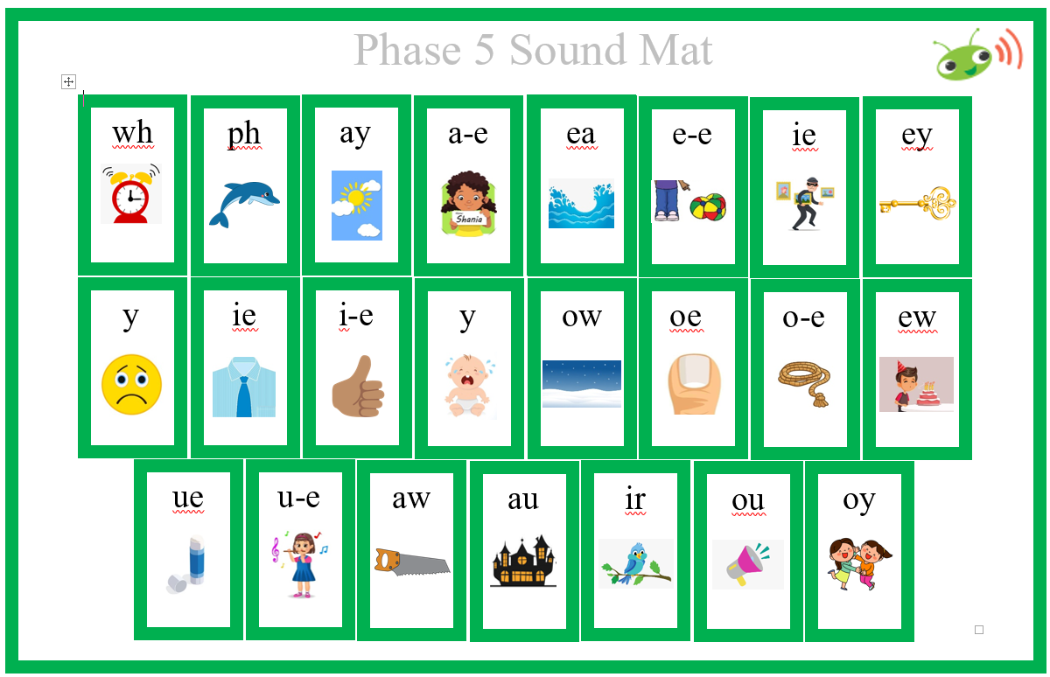
Support in school
Daily flashcards
Regular reading – 1:1, paired, whole class
Daily 30minute phonics lesson
Interventions provided where necessary
Sound mats to support with writing
Constant modelling of sounding out words when
writing

Slide 6
How you can support at home
Flashcards!
Create good habits for reading – little and often.
Read the same thing twice, three times or four times!
Use Bug Club login regularly.
Share stories at bedtime.
Be a ‘reading role model’ for your child.
When writing, remind children to spell using their phonics knowledge.
Phonics Play Website – PhonicsPlay
Spelling Shed can be changed to ‘phonics mode’.

Slide 7
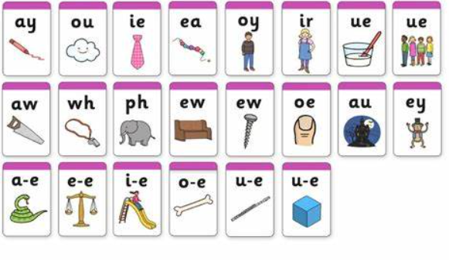
Phonics Screening Check
The Phonics Screening Check is designed to check whether pupils have a good understanding of what they have learnt in phonics so far. It started in 2012.
It is an opportunity for teachers to assess who will continue to need support with their phonics as they move into Year 2.

Slide 8
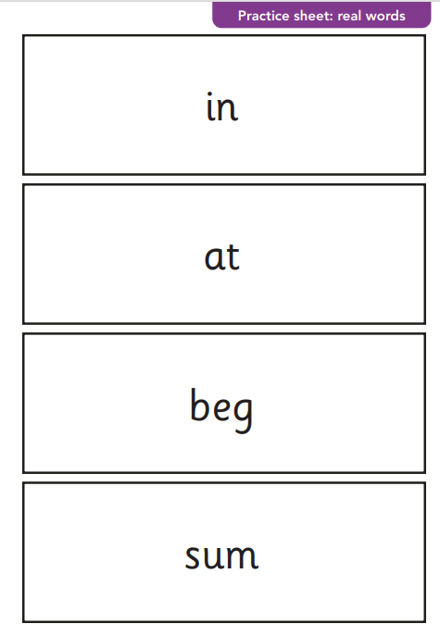
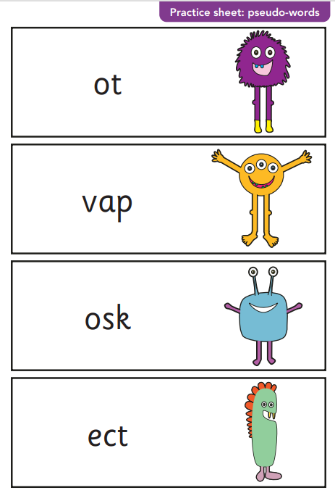
Phonics screening Check
Takes place in a quiet, comfortable space with either myself or Mrs Crew 1:1. Arrangements can be made, e.g. breaking the test up into blocks if necessary.
End of Year 1 – WB 9th June 2025
Assesses how well your child can use and apply their phonics skills of 85 sounds – not all are included in the test (40 words)
Includes real and alien words
If they don’t pass (32/40) they will retake at the end of Year 2

Slide 9

Questions

